Slide 1
Introduction to AI in Smart Manufacturing
Instructor: Ricardo Knoblauch
Slide Design: Sourish Ghosh

Slide 2
AI in Manufacturing – Why Now?
More data than ever (sensors, CNC, inspection)
Too much for humans to interpret
AI converts data into decisions

Slide 3
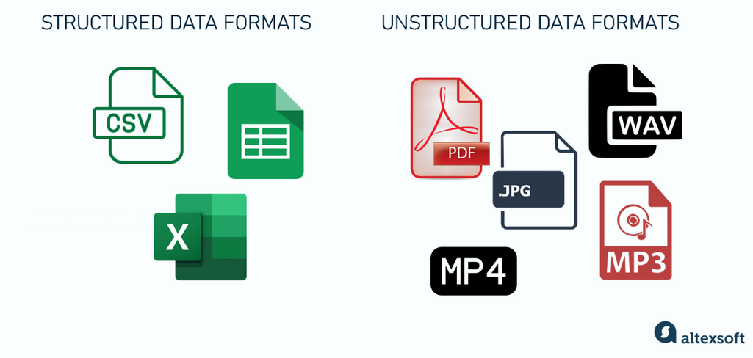
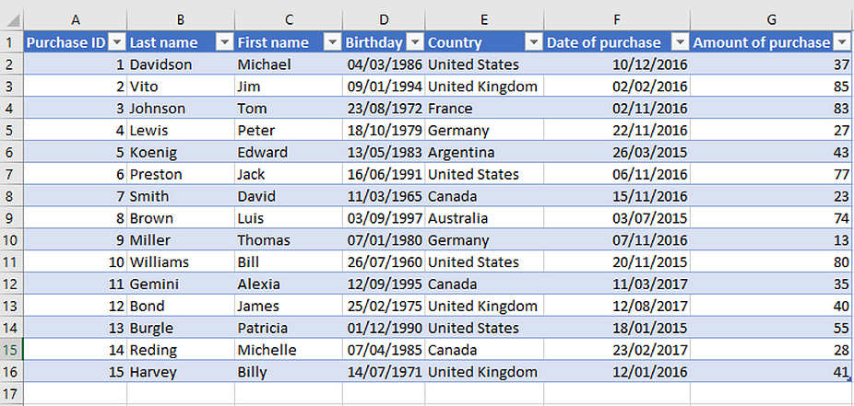
Structured Data
Organized in rows & columns
Examples: cutting speed, feed, forces, power
Easy to analyze with ML

Slide 4
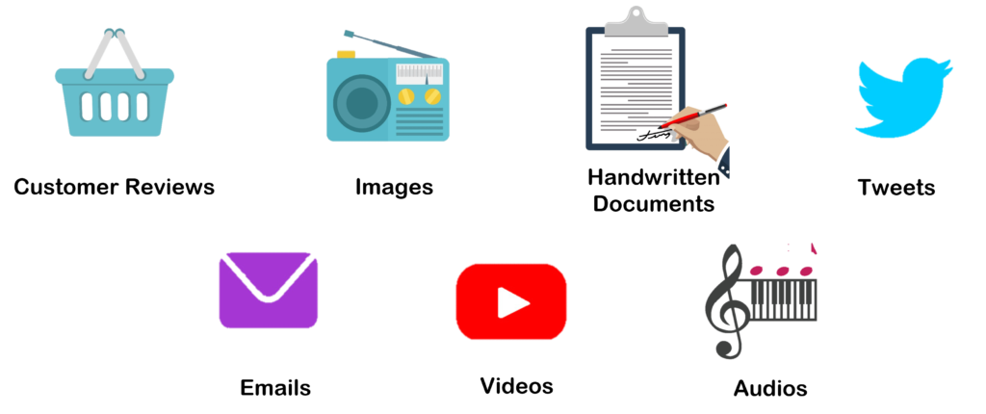
Unstructured Data
No fixed format
Examples: tool wear images, vibration signals, 3D scans
Needs advanced AI techniques

Slide 5
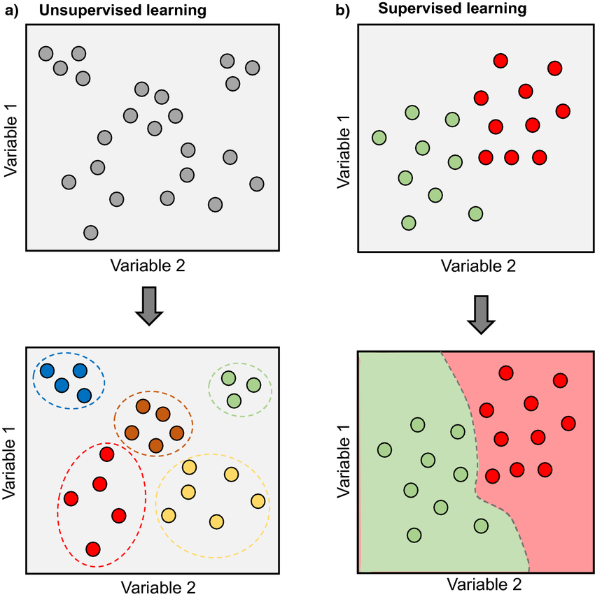
Supervised Learning
Data comes with answers (labels)
Example: parameters + measured Ra
Model learns input → output

Slide 6
Unsupervised Learning
Data without labels
Model finds hidden groups
Example: clustering surface data across feed rates

Slide 7
Classification
Predicts categories (labels)
Example: Tool wear {Fresh, Worn, Broken}
Used in fault diagnosis, roughness group prediction etc.

Slide 8
Regression
Predicts continuous values
Example: cutting parameters → Ra (µm)
Used for quality prediction

Slide 9
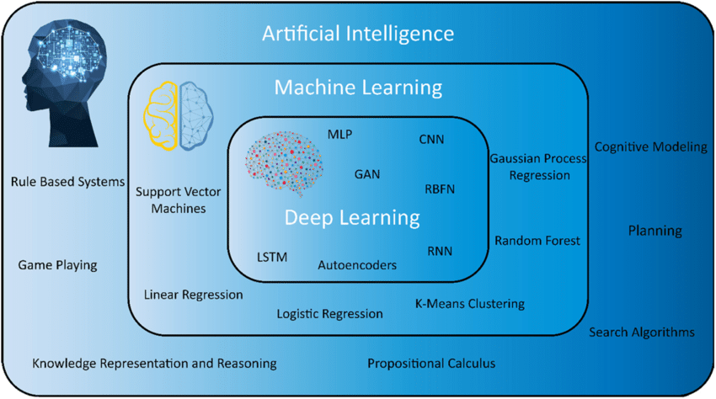
AI, ML, and DL Overview
Artificial Intelligence (AI): Broad field of making machines 'intelligent’ eg: Logic Systems
Machine Learning (ML): Subset of AI, learns patterns from data
Deep Learning (DL): Subset of ML, uses neural networks for complex problems

Slide 10
Machine Learning – What It Is
Learns automatically from data
Improves with more data
Captures complex relations
Prediction without explicit programming
Decision Tree
Support vector Machine

Slide 11
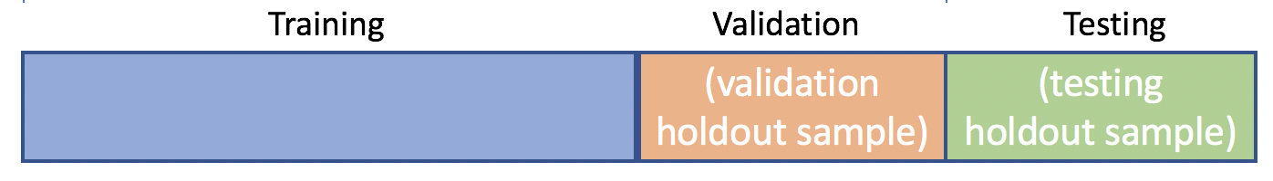
Training, Validation, Testing
Training = practice data
Validation = tuning (mock exam)
Testing = final exam
Prevents overfitting
80%
10%
10%

Slide 12
ML Workflow in Manufacturing
Collect machining data
Preprocess (clean, normalize, extraction)
Train + validate + test model
Deploy on shop floor

Slide 13

Predicting Surface Roughness
Inputs: Vc, F, ap, Fa, Fn
Output: Ra
Learned from experiments
Link to the Google Colab .ipynb file
Google Colab Notebook

